Slide 1
7th Hour
Big Idea: Egyptian Myths
Venn Diagrams
Exit Slips!!

Slide 2
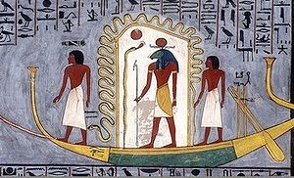
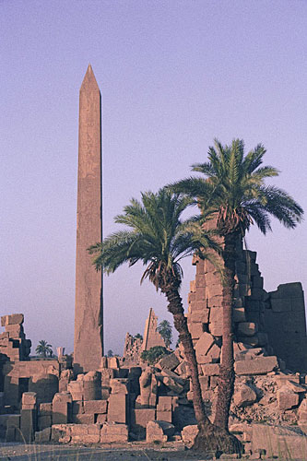
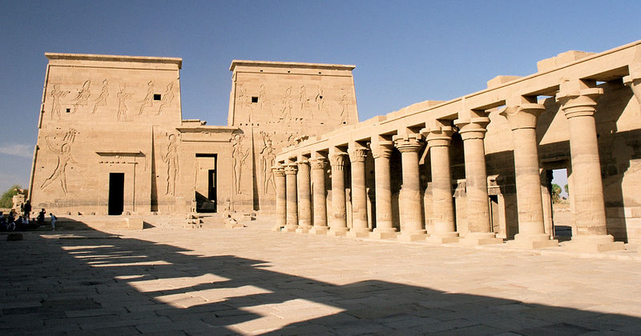
Bell Work
Write down 3 things that you already know about Egyptian religion.

Slide 3
Vocabulary Development
What is a myth?
A traditional story involving early history usually involving supernatural things
What is a theme?
The main idea of a story, what the story is really about
What is a character?
A person in the story.

Slide 4
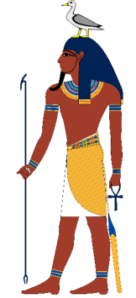
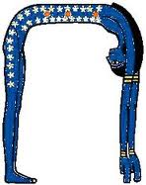
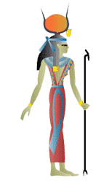
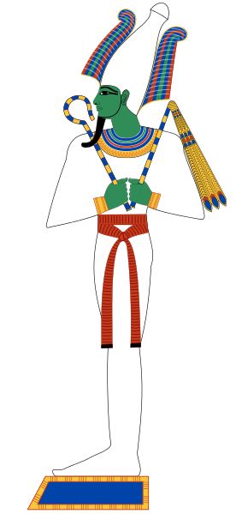
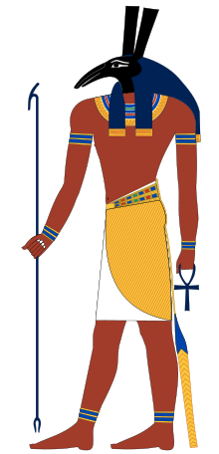
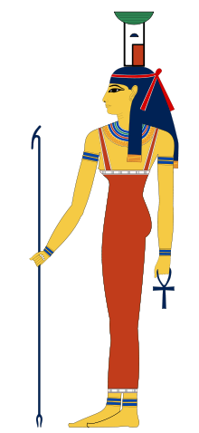
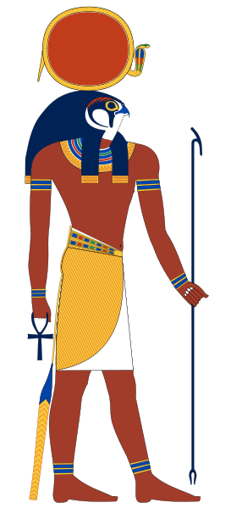
Geb
+
Nut
+
+
Isis
Set
Nephtys
Osiris
The Divine Family Tree
Horus

Slide 5
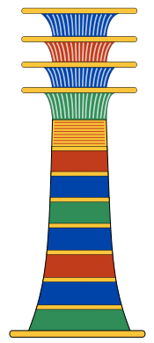
Pre-Reading
Plutarch
A Greek Historian that wrote down the stories of Egypt’s religion in Roman times
Pillar (Djed)
A symbol of Osiris, the tree that hid Osiris’ body

Slide 6
Geb
+
Nut
+
+
Isis
Set
Nephtys
Osiris
The Divine Family Tree
Horus

Slide 7
Venn Diagram
Love
Anger

Slide 8
Venn Diagram
Osiris
Set

