Slide 1
Higher Level Questions
12th Grade English 2nd Block

Slide 2
Levels of Questioning
Level 1: Gathering
The answers are right there in the text.
Level 2: Processing
The answers require multiple ideas from the text to be brought together.
Level 3: Applying
The answers require application to ideas/situations outside the text.

Slide 3
What happens?
Who it’s about?
How do the characters change?
What motivates the characters?
What are the themes?
Why does it happen this way?
How does this apply to the real world?

Slide 4
The Giving Tree http://the-giving-tree.info/

Slide 5
Read the story together as a table group. (Make sure to write the title of your book on your paper).
Individually, write a level 1, 2, and 3 question.
Use your group members if you need help, but each person should have different questions.
Discuss your questions when everyone is finished.

Slide 7
Frankenstein The Four Letters
12th Grade English 2nd Block

Slide 8
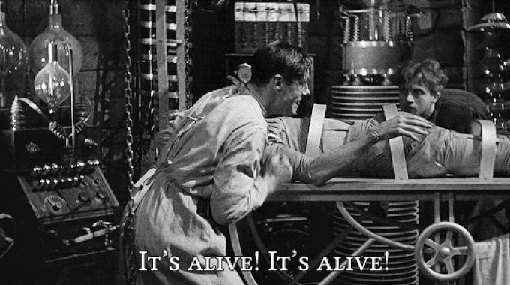
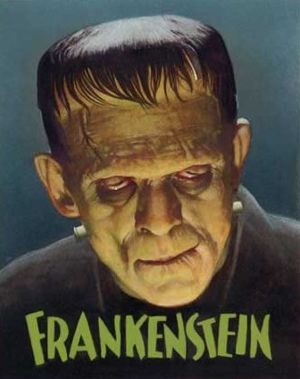
Pre-Reading
What does Frankenstein make you think of?
What do you already know about the story?
Make a prediction about the plot and themes?

Slide 9
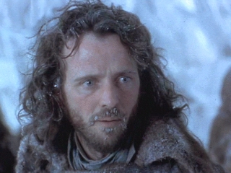
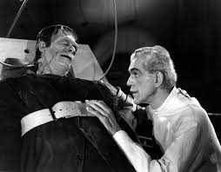
Robert Walton
Victor Frankenstein

Slide 10
The Four Letters
Individually, read and annotate.
Discuss the reading guide questions with your table group. Each person needs to write down their own answers.
Be able to summarize and identify the central ideas. Your table group will be responsible to teach your section to the whole class.

