Slide 1
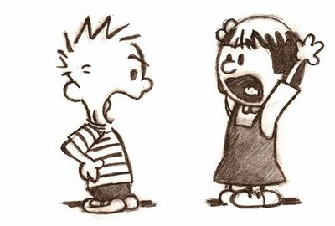
Person vs. Self
Person vs. Nature
Person vs. Person
Person vs. Society

Slide 2
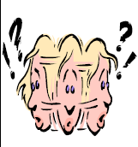
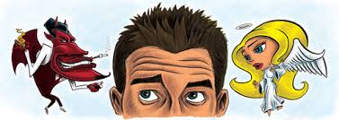
Person vs. Self
Internal Conflict
A struggle between the character and his/her own conscience.
Examples?

Slide 3
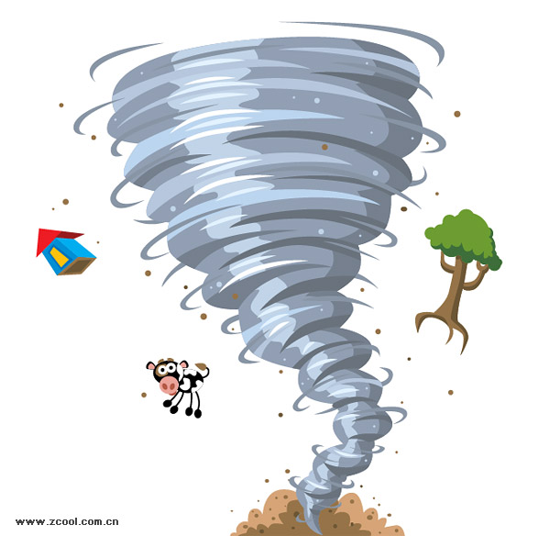
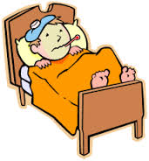
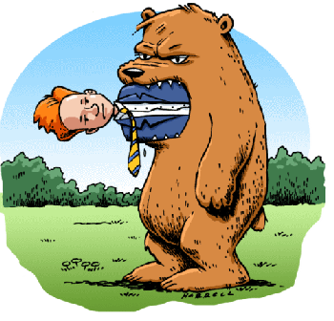
Person vs. Nature
External Conflict
A struggle between the character and elements of nature that he/she cannot control.
Examples?

Slide 4
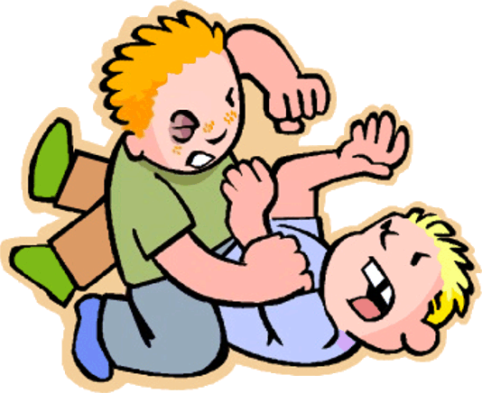
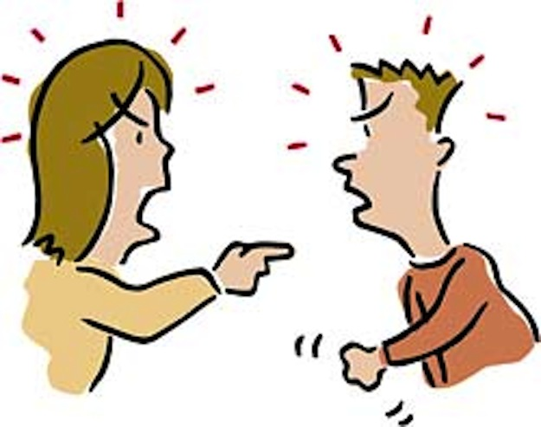
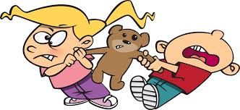
Person vs. Person
External Conflict
A struggle, mental or physical, between two characters in the story.
Examples?

Slide 5
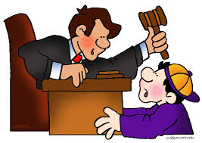
Person vs. Society
External Conflict
A struggle between the character and the rules or laws of the society where he/she lives.
Examples?

